Slide 1
EE2003: Computer Organization & Assembly Language
1 – An Introduction
Notes:
<number>

Slide 2
Outline
About this Course
Basic Structure of Computer
What is Computer Organization?
About Assembly Language
<number>

Slide 3
What is this course about?

Slide 4
Course Objectives
To understand organization of a computer system
To gain an insight knowledge about the internal architecture and working of microprocessors.
To understand working of memory devices, interrupt controllers and I/O devices.
To learn Assembly Language
To understand how low level logic is employed for problem solving by using assembly language as a tool.
<number>

Slide 5
Course Contents
Basic Structure & Components of a Computer System
Difference in Computer Organization & Computer Architecture
Computer Evolution
Microprocessor & Microcontrollers
Interconnection Structures
Memory Organization
Data Representation
Instruction Set
Processor Structure & Function
Interrupts
Processor Registers & FLAGS
<number>

Slide 6
Course Contents Contd..
Assembly Language
Syntax
Basic Instructions
Flow Control Instructions
High Level Language Structures
Logic, Shift and Rotate Instructions
The Stack
Multiplication & Division Instructions
Array & Addressing Modes
String Instructions
Procedures & Macros
Translation of high level language into assembly language.
<number>

Slide 7
Basic Structure & Function – Computer System
Notes:
<number>

Slide 8
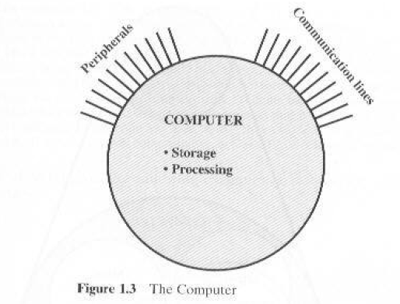
Structure
Structure is the way in which components relate to each other
<number>
Notes:
<number>

Slide 9
Difference in Peripherals & Communication Lines
When data is received from or delivered by a device that is directly connected to the computer, process is called Input-Output (I/O).
When data are moved over longer distance, to or from a remote device, the process is known as Data Communication.
<number>

Slide 10
Structure - Top Level
Peripherals
Computer
Central
Processing
Unit
Main
Memory
Computer
Systems
Interconnection
Input
Output
Communication
lines
<number>
Notes:
<number>

Slide 11
Structure – Top Level Contd..
Four main structural components:
CPU: controls the operation of the computer and performs its data processing functions; often referred as processor.
Main Memory: stores data
I/O: moves data between the computer and its external environment.
System Interconnections: Mechanism for communication among CPU, memory, and I/O.
<number>

Slide 12
Structure - The CPU
CPU
Computer
Arithmetic
and
Login Unit
I/O
Registers
System
Bus
CPU
Internal CPU
Interconnection
Memory
Control
Unit
<number>
Notes:
<number>

Slide 13
Structure – The CPU
Control Unit: controls the operation of CPU and hence the computer.
Arithmetic and logic unit: performs the computer’s data processing functions.
Registers: provides storage internal to CPU.
CPU interconnection: Mechanism that provides for communication among the control unit, ALU, and registers.
<number>

Slide 14
Structure - The Control Unit
Control Unit
CPU
ALU
Sequencing
Logic
Internal
Bus
Control
Unit
Control Unit
Registers and
Decoders
Registers
Control
Memory
<number>
Notes:
<number>
Several approaches for CU implementation
1 approach is Micro programmed Control unit which is programmed to execute micro instructions.

Slide 15
Function
Function is the operation of individual components as part of the structure.
Main functions performed by a computer system are:
Process Data
Store Data
Move Data
Control the above three functions
<number>
Notes:
<number>

Slide 16
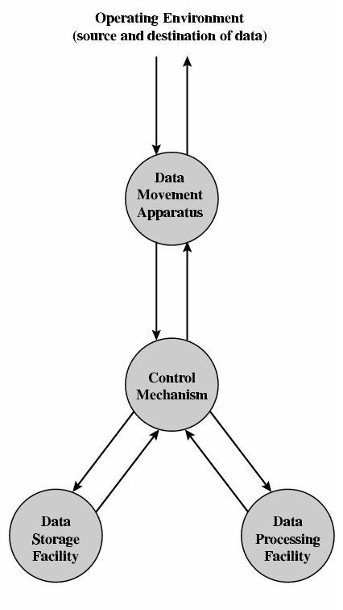
Functional View of Computer
<number>

Slide 17
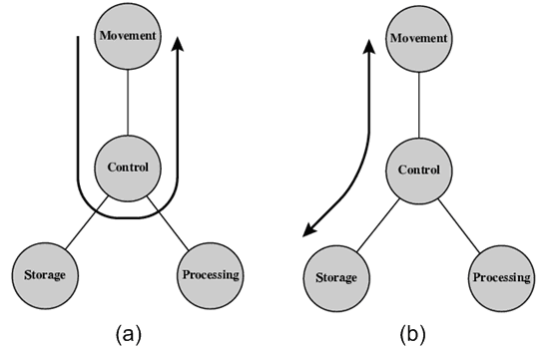
Possible Operations
Data movement device
Data storage device (read/write)
<number>

Slide 18
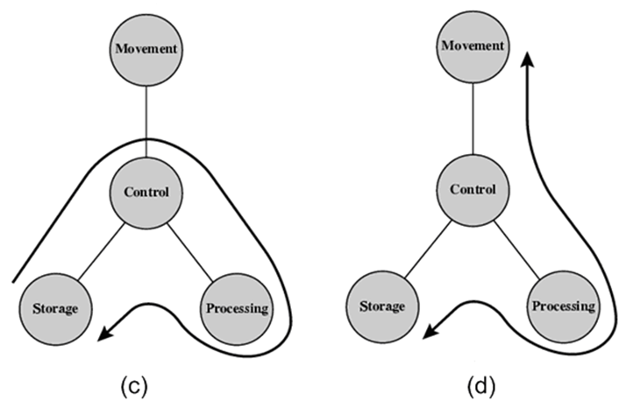
Possible Operations Contd..
Processing on data stored in storage or in external environment
<number>

Slide 19
What is Computer Organization?
Notes:
<number>

Slide 20
Computer Architecture
Computer Architecture refers to those attributes of a system visible to a programmer
Those attributes that have direct impact on logical execution of a program.
Architectural attributes include:
the instruction set,
no. of bits used to represent various data types (numbers, characters etc),
I/O mechanisms and technology for addressing memory.
Example: Architectural design issue whether a computer will have multiply instruction or not.
<number>
Notes:
Architecture = Logical aspects
Explain the terms underlined
<number>

Slide 21
What is Computer Organization?
Organization is how features are implemented.
How does a Computer Work?
For Example: Is there a special hardware multiply unit for multiplication operation or is it done by repeated addition?
Computer Organization refers to the operational units and their interconnections that realize the architectural specifications.
Organizational attributes:
hardware details transparent to the programmer such as control signals,
interfaces between peripherals and the computer,
the memory technology used.
<number>
Notes:
Organization = physical aspects
How numbers will be multiplied & where result will be stored!
<number>

Slide 22
Computer Organization vs. Architecture
Architecture:
Logical aspects of computer hardware that are visible to the programmer
What instruction a computer understands!
Organization:
Physical aspects of computer hardware that are invisible to the programmer
How does the computer hardware carries out instructions!
<number>

Slide 23
Computer Organization vs. Architecture Contd..
Computer Organization must be designed to implement a particular architectural specifications.
It is possible to have same architecture but different organizations.
All computers in the Intel Pentium series have the same architecture.
Each version of the Pentium has a different organization or implementation.
<number>

Slide 24
Computer Organization vs. Architecture Contd..
Architectural Issues:
Reduced Instruction Set Computing (RISC)
Complex Instruction Set Computing (CISC)
Pipeline etc
Organizational Issues:
I/O, control unit, memory etc
<number>

Slide 25
Why Study Computer Organization?
Understand how computer works!
Computer functional components, their characteristics, their performance, and their interactions.
How to select a system?
Understand tradeoff among various components, such as memory size, CPU clock speed etc.
<number>

Slide 26
Assembly Language

Slide 27
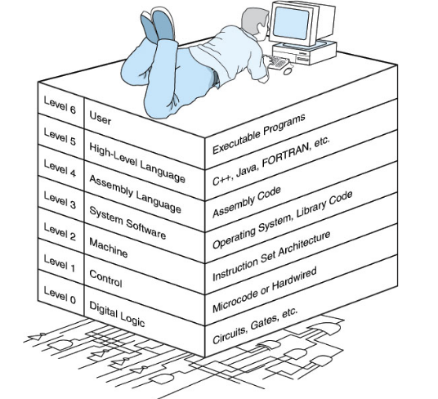
Computer Level Hierarchy
Figure Reference: http://users.dickinson.edu/~braught/courses/cs251f09/topics/slides/intro.pdf
<number>

Slide 28
Programming Languages
High-Level Languages (HLL)
Assembly Language
Machine Language
<number>

Slide 29
High-Level Language
Allow programmers to write programs that look more like natural language.
Examples: C++, Java, C#.NET etc
A program called Compiler/Interpreter is needed to translate a high-level language program into machine code.
Each statement usually translates into multiple machine language instructions.
<number>

Slide 30
Machine Language
The "native" language of the computer
Numeric instructions and operands that can be stored in memory and are directly executed by computer system.
Each ML instruction contains an op code (operation code) and zero or more operands.
Examples:
Opcode Operand Meaning
-------------------------------------------------
40 increment the AX register
05 0005 add 0005 to AX
<number>

Slide 31
Assembly Language
Use instruction mnemonics that have one-to-one correspondence with machine language.
An instruction is a symbolic representation of a single machine instruction
Consists of:
label always optional
mnemonic always required
operand(s) required by some instructions
comment always optional
<number>

Slide 32
Sample Program
<number>

Slide 33
Figure: Machine Language Generation by ASM and HLL programs.
<number>

Slide 34
Essential Tools
Assembler is a program that converts source-code programs into a machine language (object file).
Linker joins together two or more object files and produces a single executable file.
Debugger loads an executable program, displays the source code, and lets the programmer step through the program one instruction at a time, and display and modify memory.
Emulator allows you to load and run assembly language programs, examine and change contents of registers. Example: EMU8086
<number>

Slide 35
Why Learn Assembly Language?
Learn how a processor works
Explore the internal representation of data and instructions
How to structure a program so it runs more efficiently.
Compilers/Device Drivers/ OS codes
Games/Embedded System
<number>
Notes:
<number>

